Slide 1


Using a reservoir-based molecular dynamics approach to rapidly converge new Hamiltonians. Matt Kochert, Dr. Koushik Kasavajhala, and Dr. Carlos Simmerling MDAnalysis UGM 2025

Slide 2
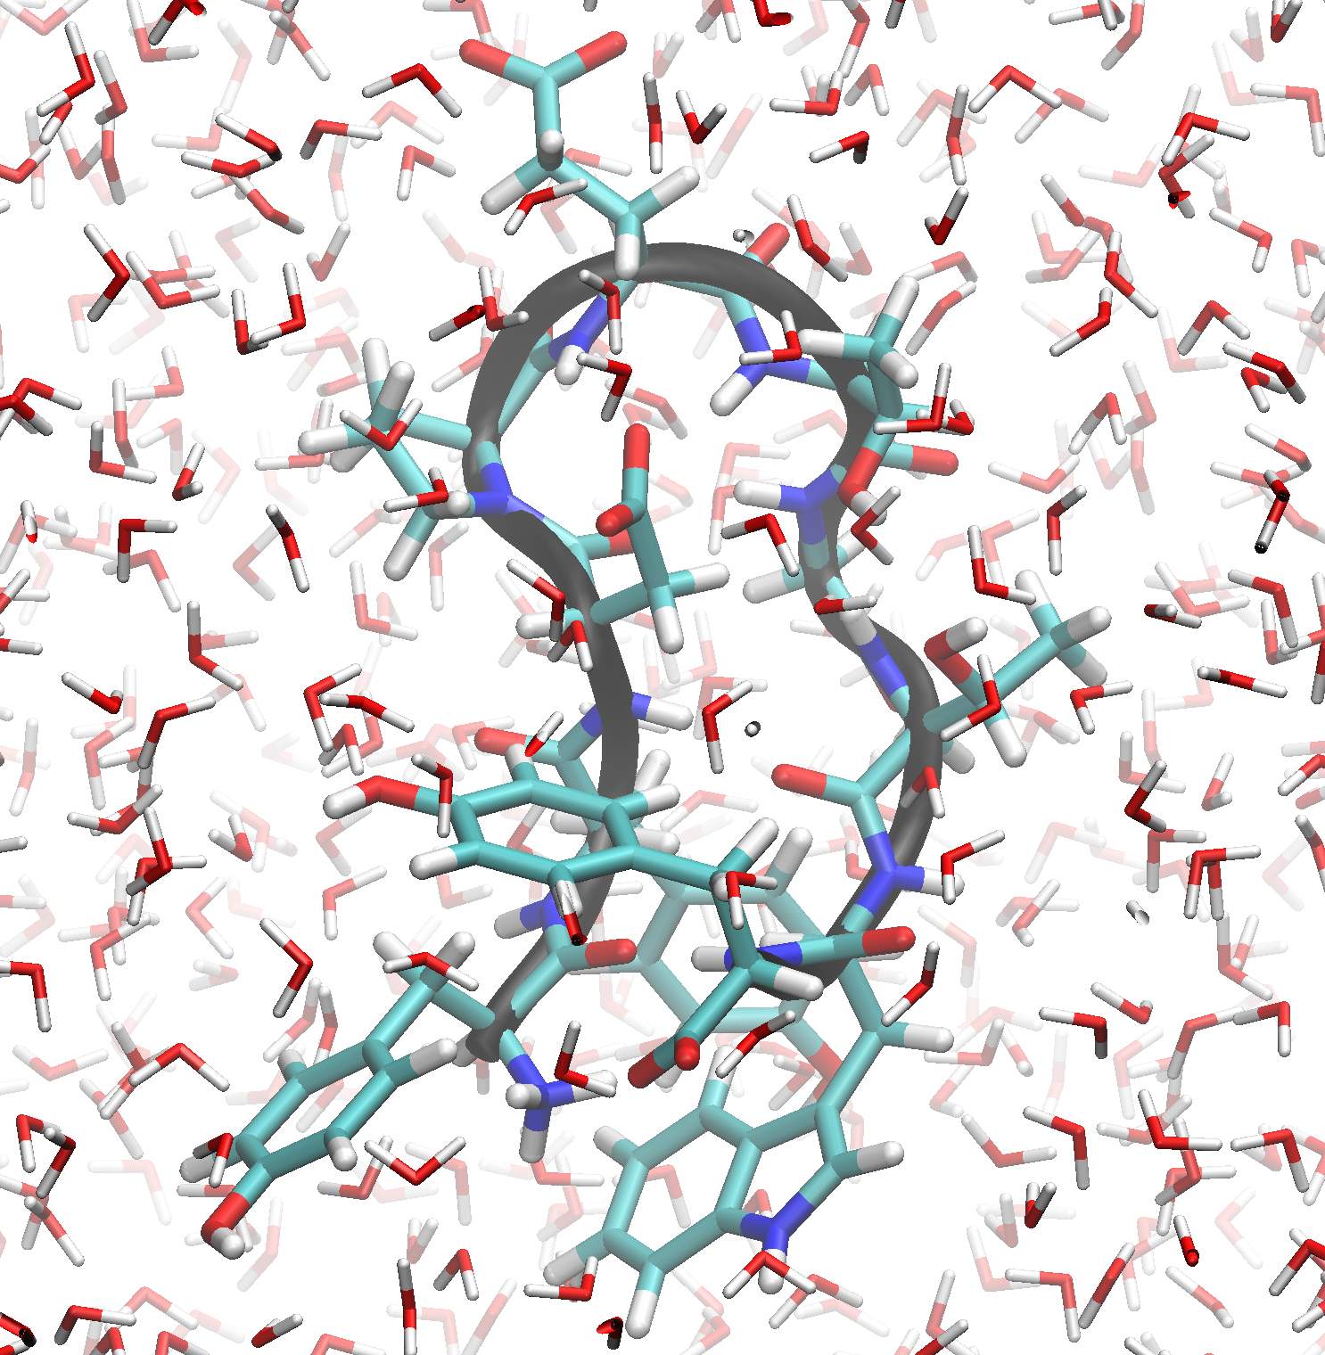
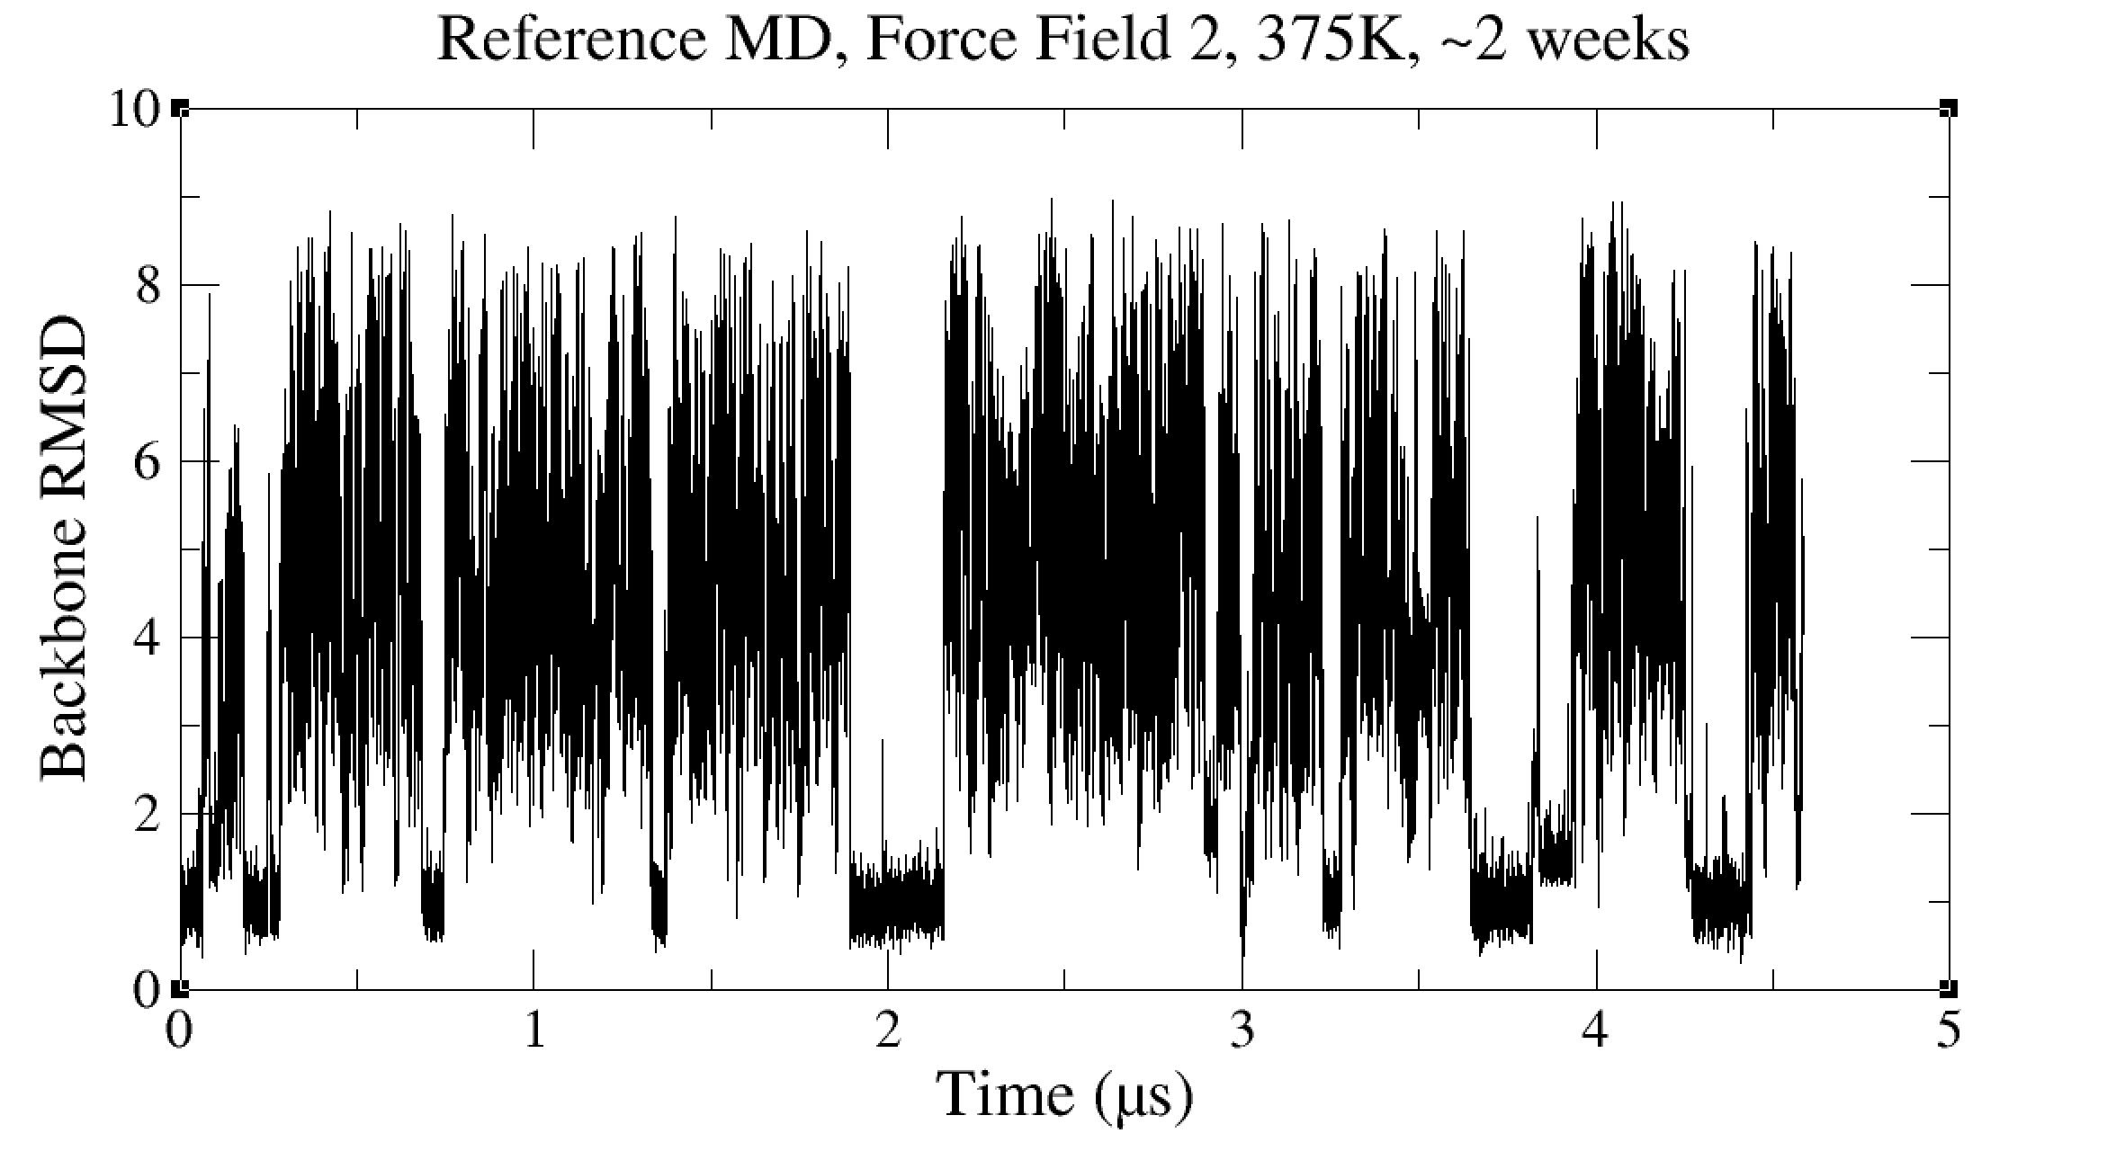
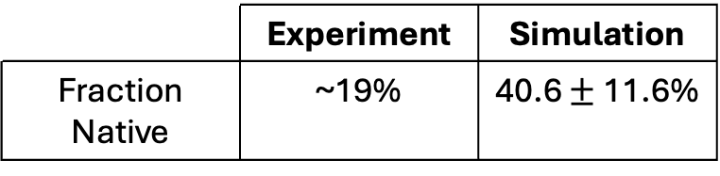
How to best generate multiple ensembles under different conditions?
You have a machine learning potential that works well for your system of interest but calculations using it are too slow.
You are doing force field development and need to simulate the same system with many force field candidates.
CLN025 with ff14SBonlysc/OPC, 375K, ~2 weeks
 | Experiment | Simulation
Fraction Native | ~19% | 40.6 $±$ 11.6%
Honda, S.; Akiba, T.; Kato, Y.; Sawada, Y.; Sekijima, M.; Ishimura, M.; Ooishi, A.; Watanabe, H.; Odahara, T.; Harata, K. 2008 J. Am. Chem. Soc. 130, 15327-15331.
Notes:
Change this slide – more general

Slide 3
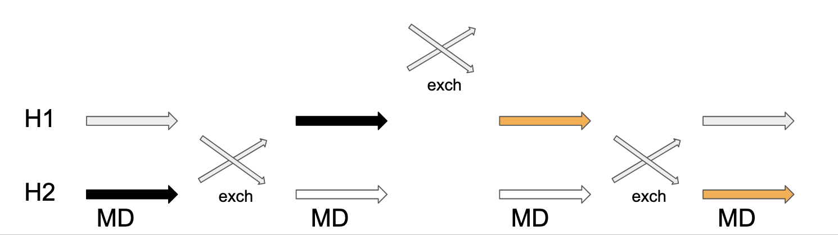
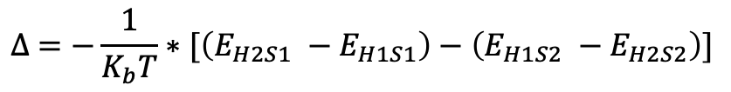
How to best generate multiple ensembles under different conditions?
HREMD Protocol
Can we run HREMD on its own?
Not really
-Need to run at target T, which makes conformational sampling slow.
-This means it takes a long time to get diverse structures to trade between each H.
-Can run 2D, but this is extremely expensive computationally
$$∆ =−\frac{1}{K_{b}T}∗[\left(E_{H2S1} −E_{H1S1}\right)−\left(E_{H1S2} −E_{H2S2}\right)]$$
Sugita, Y.; Okamoto, Y. 1999 Chemical Physics Letters 314 (1-2), 141-151.
Fukunushi, H.; Watanabe, O.; Takada, S. 2002 J Chem. Phys. 116, 9058-9067.
Notes:
Can mention 2D which is possible but in explicit solvent is extremely computationally expensive

Slide 4
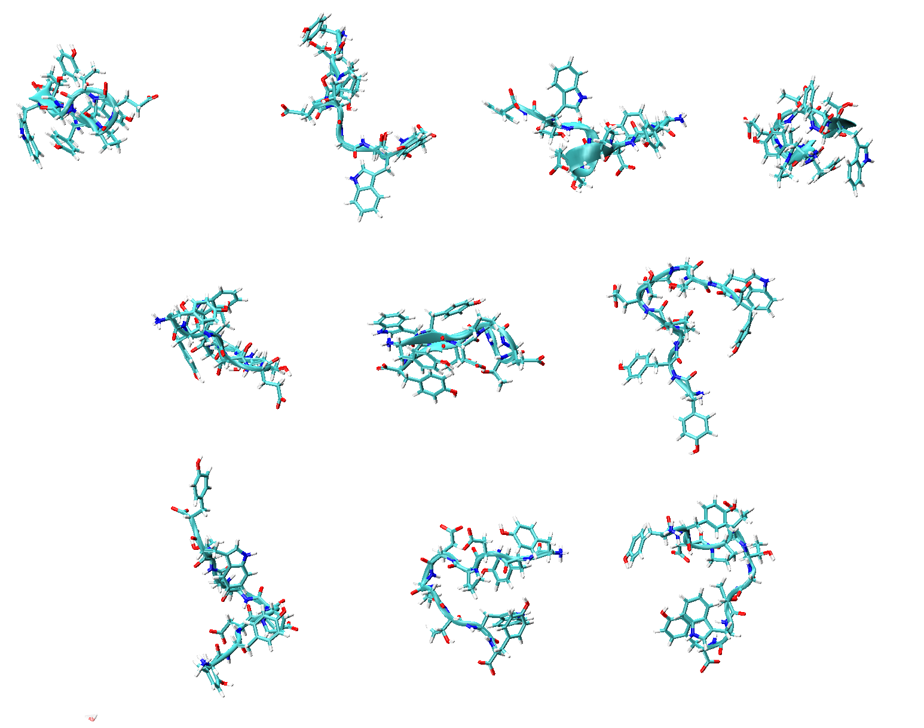
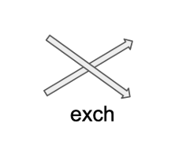
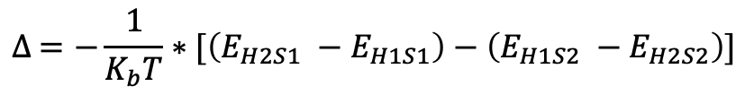
$$∆ =−\frac{1}{K_{b}T}∗[\left(E_{H2S1} −E_{H1S1}\right)−\left(E_{H1S2} −E_{H2S2}\right)]$$

Slide 5
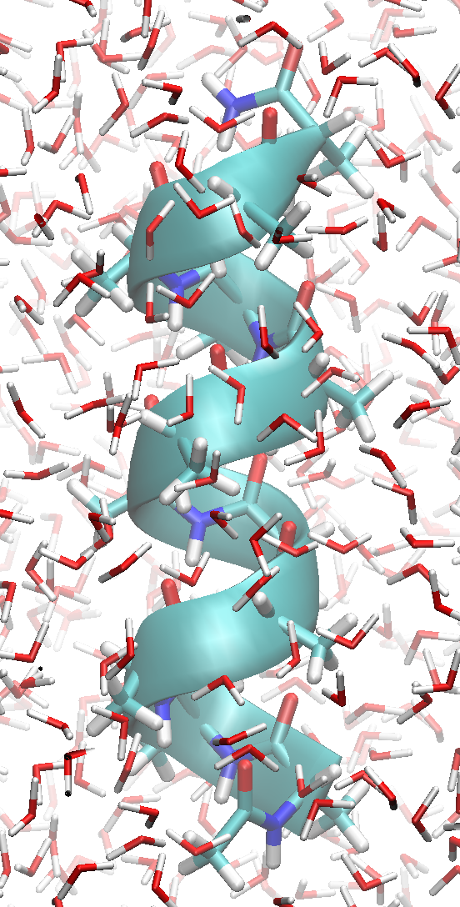
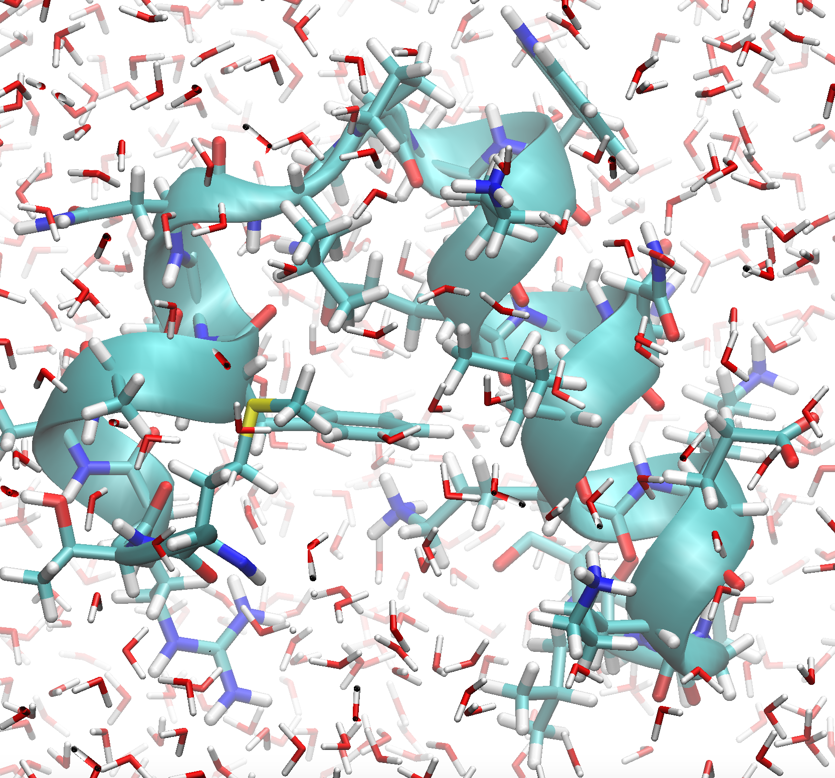
CLN_025
Alanine-12
HP24
Hocking, H.; Häse, F.; Madl, T.; Zacharias, M.; Rief, M.; Žoldák, G. 2015 Biophysical journal 108, 678-686

Slide 6
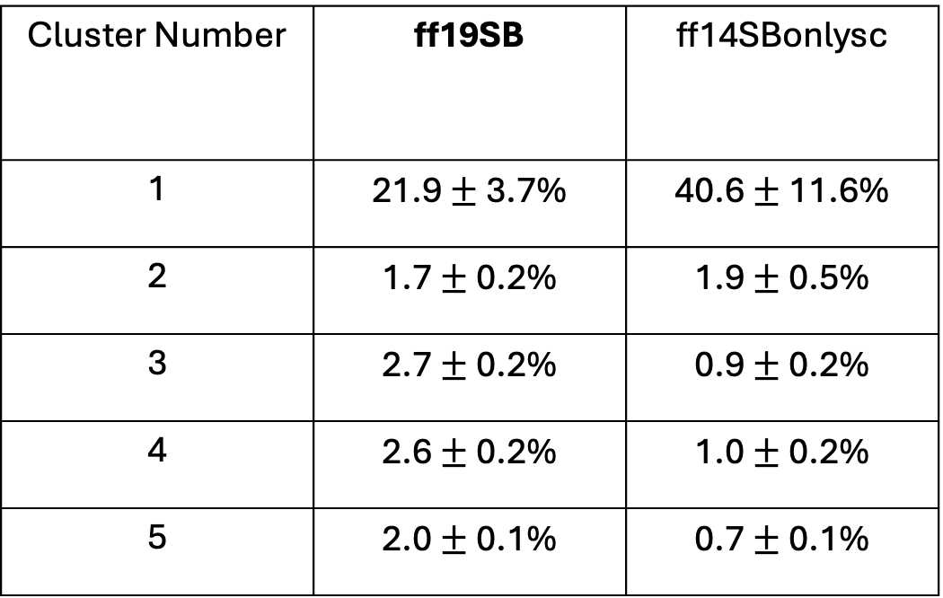
Cluster populations from clustering of all CLN025 MD trajectories
Cluster Number | ff19SB | ff14SBonlysc
1 | 21.9 $±$ 3.7% | 40.6 $±$ 11.6%
2 | 1.7 $±$ 0.2% | 1.9 $±$ 0.5%
3 | 2.7 $±$ 0.2% | 0.9 $±$ 0.2%
4 | 2.6 $±$ 0.2% | 1.0 $±$ 0.2%
5 | 2.0 $±$ 0.1% | 0.7 $±$ 0.1%

Slide 7
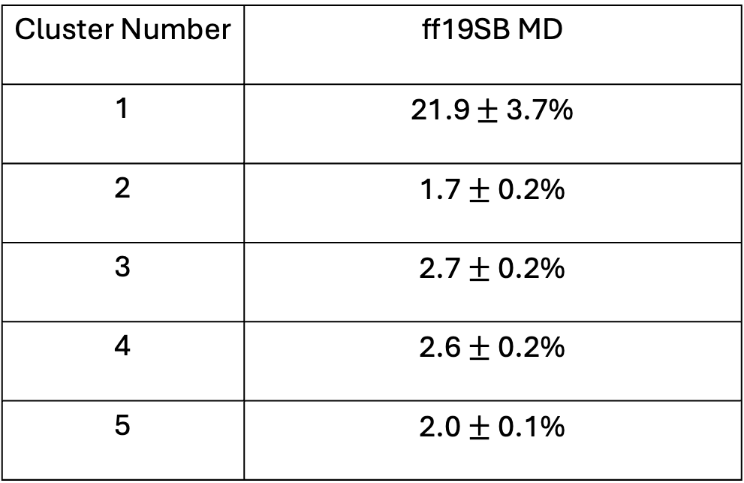
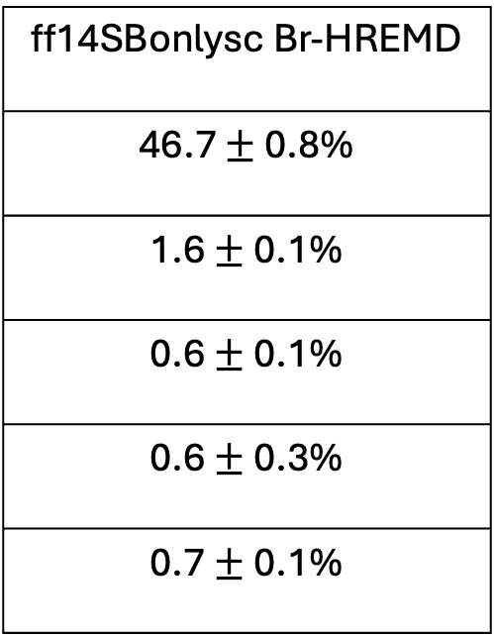
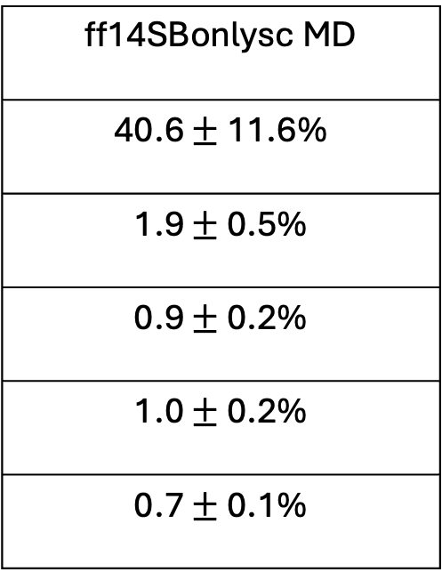
~3 months GPU time!
~3 months GPU time!
~2 hours GPU time!
Cluster Number | ff19SB MD
1 | 21.9 $±$ 3.7%
2 | 1.7 $±$ 0.2%
3 | 2.7 $±$ 0.2%
4 | 2.6 $±$ 0.2%
5 | 2.0 $±$ 0.1%
ff14SBonlysc MD
40.6 $±$ 11.6%
1.9 $±$ 0.5%
0.9 $±$ 0.2%
1.0 $±$ 0.2%
0.7 $±$ 0.1%
ff14SBonlysc Br-HREMD
46.7 $±$ 0.8%
1.6 $±$ 0.1%
0.6 $±$ 0.1%
0.6 $±$ 0.3%
0.7 $±$ 0.1%

Slide 8
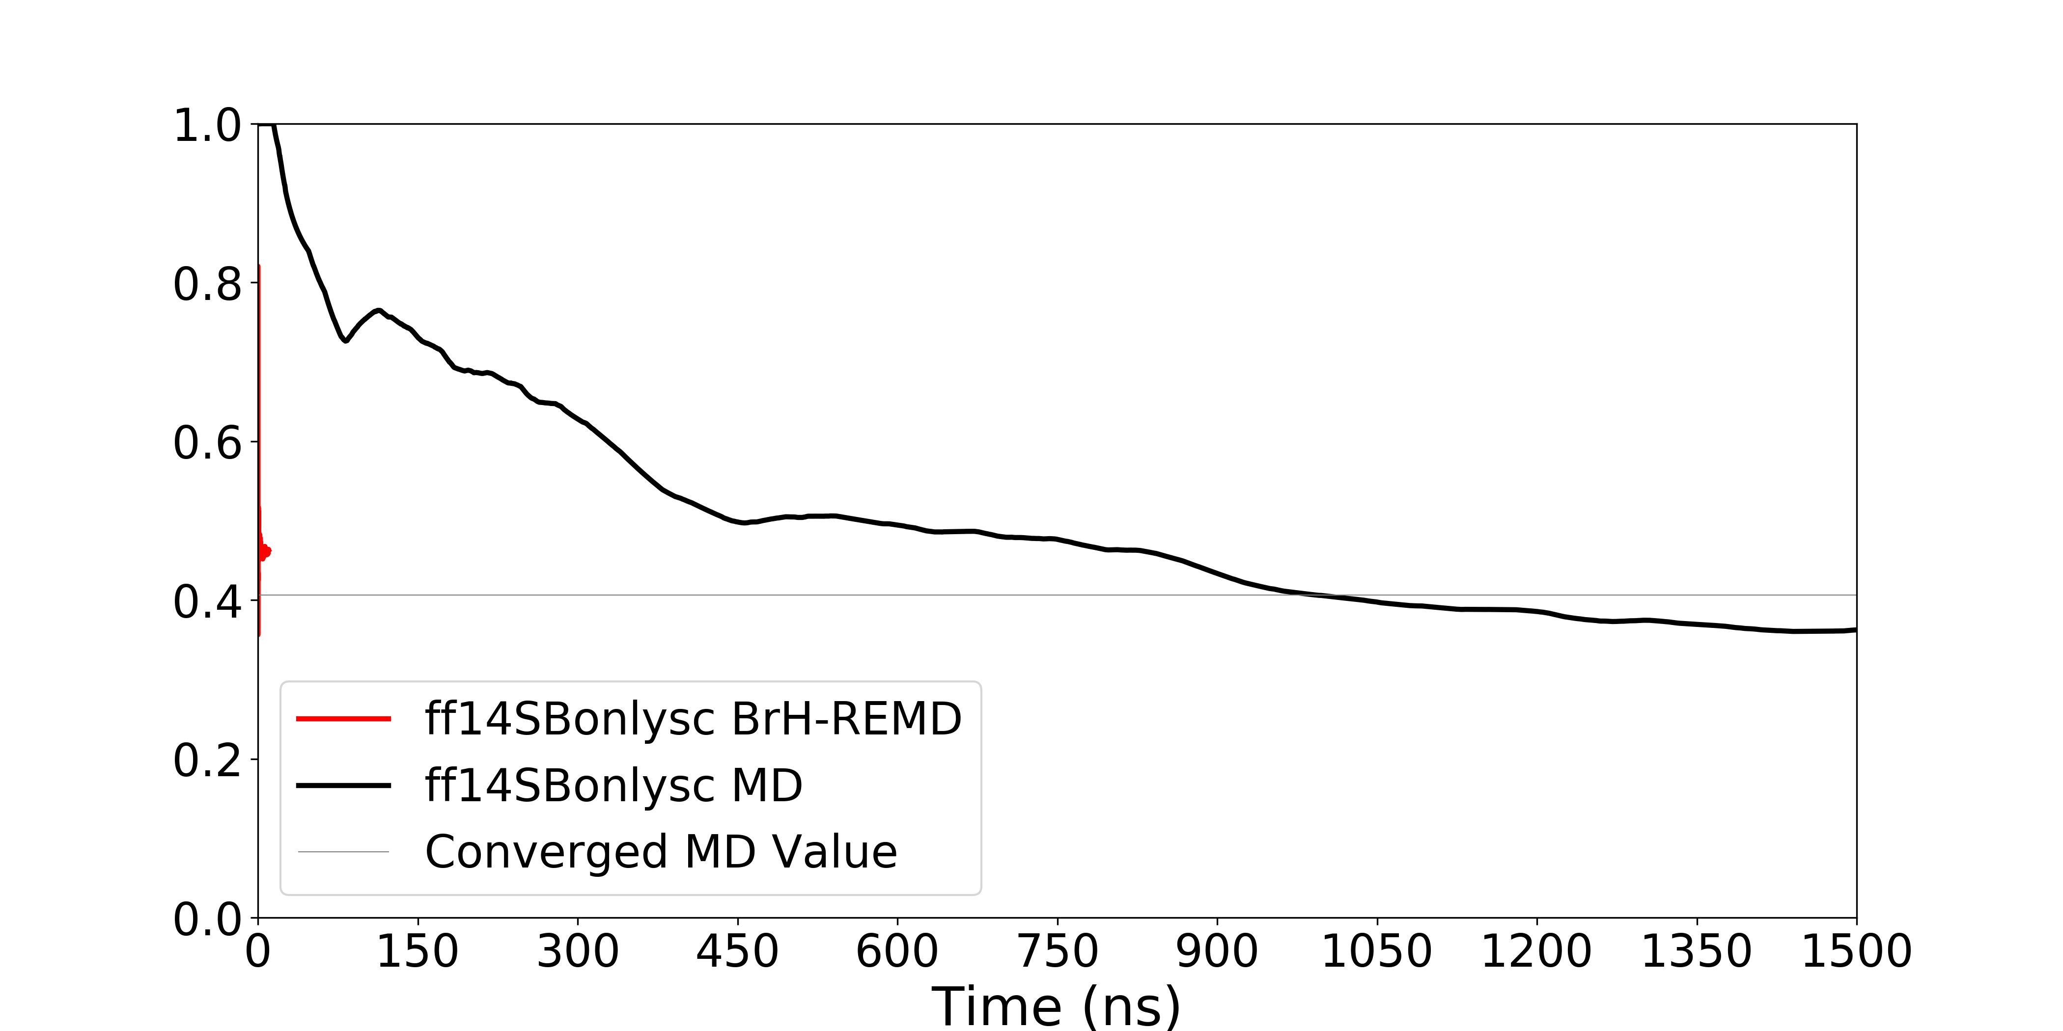
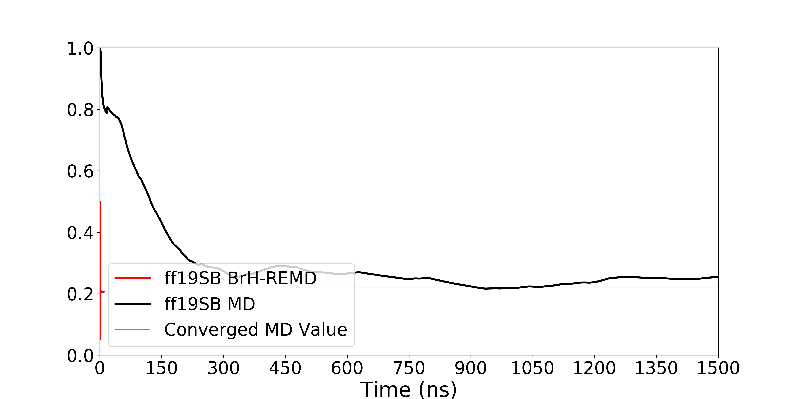
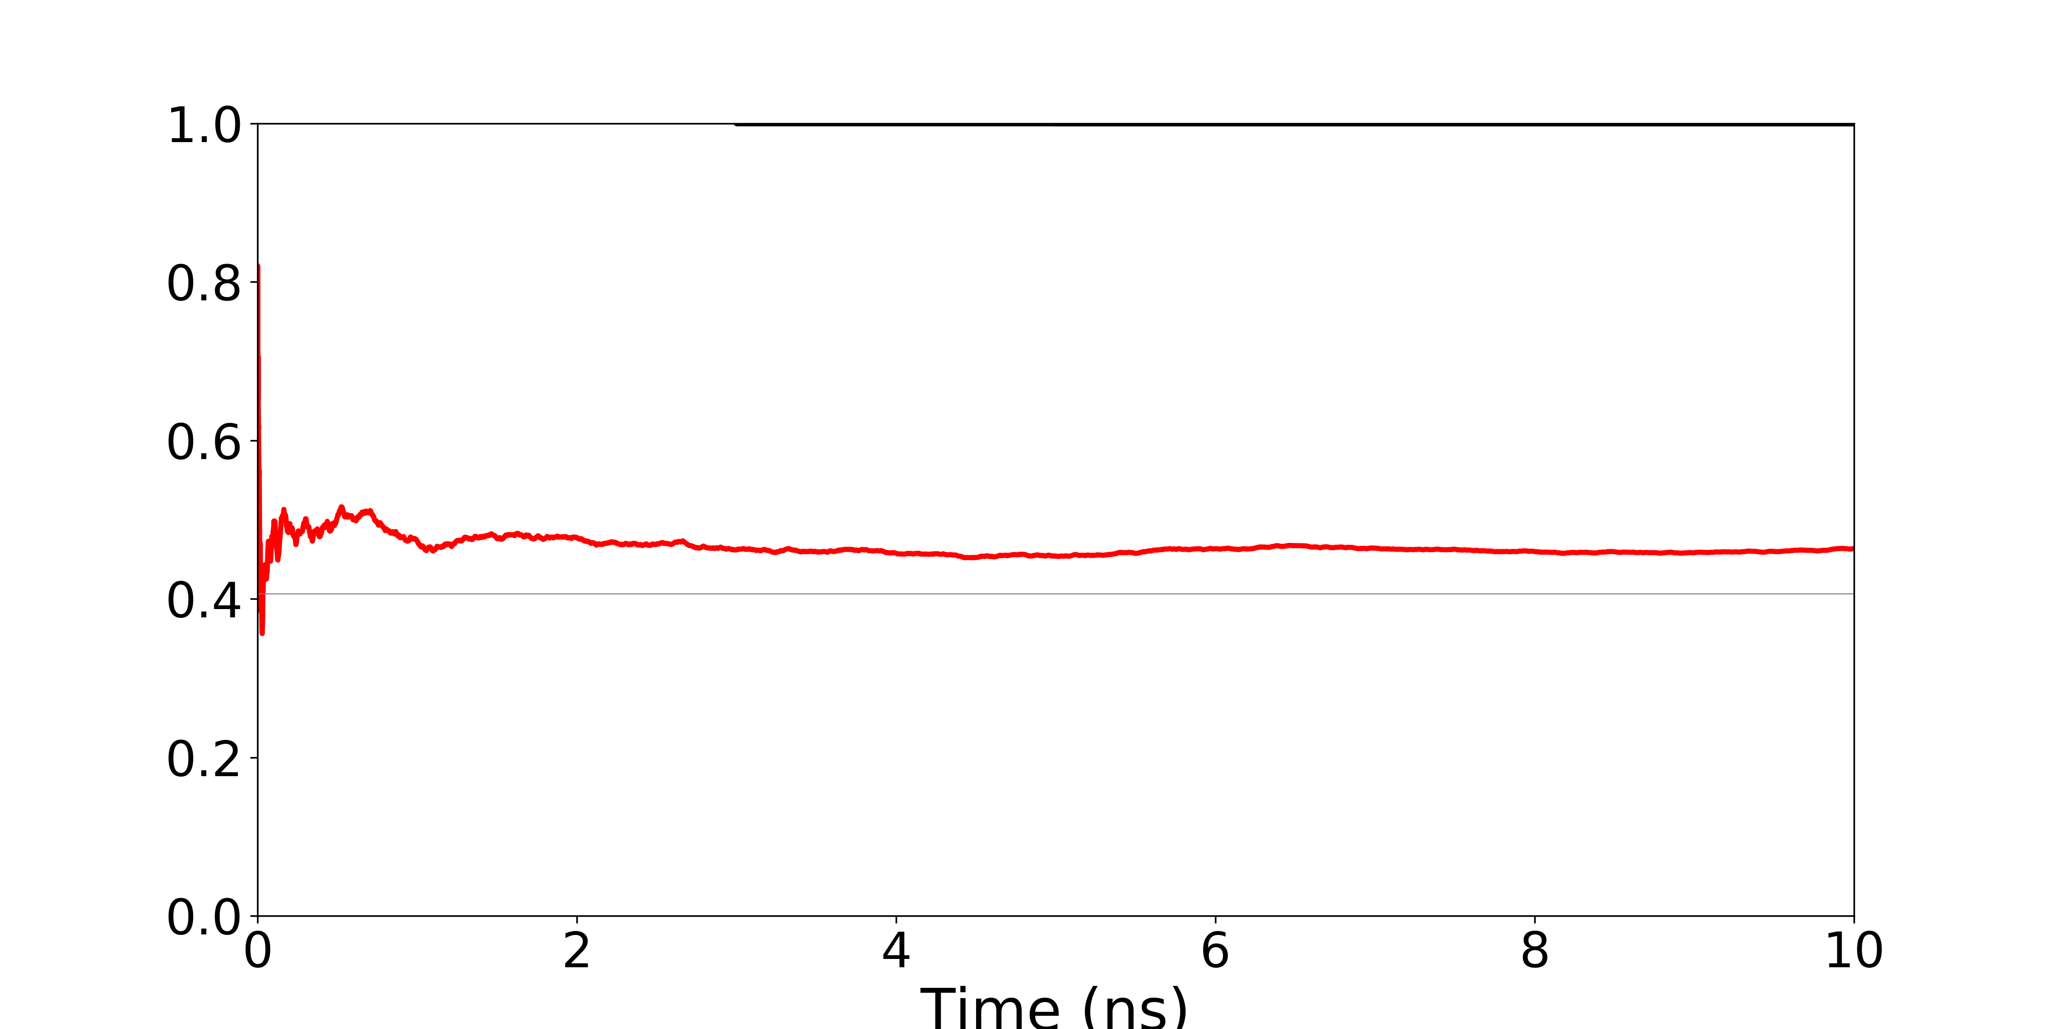
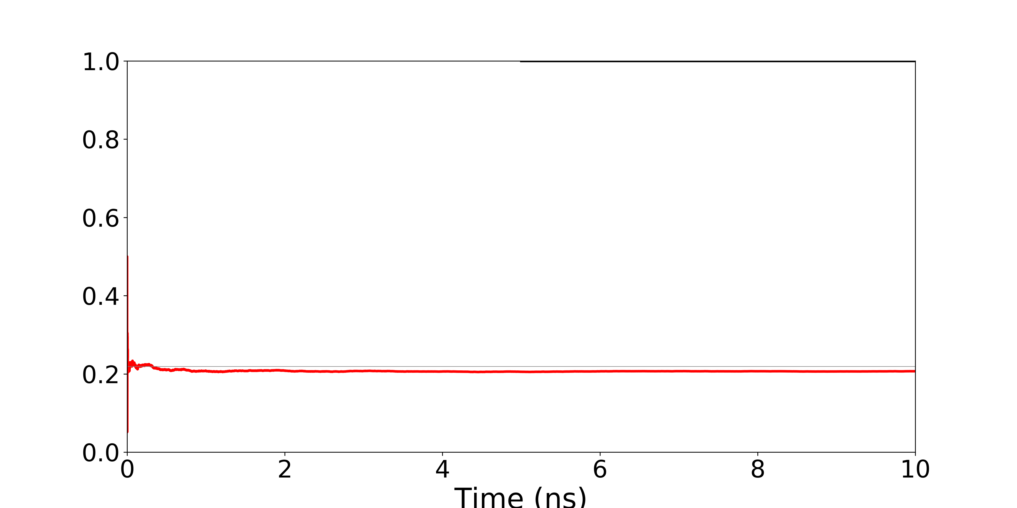
Fraction of native population vs time for MD, Br-HREMD

Slide 9
Conclusions
Simulating a protein with multiple force fields is often cost prohibitive.
Br-HREMD allows us to rapidly generate new, well-converged ensembles for a system with different force fields than one we have already simulated.
Requires overlap between force fields to exchange sufficiently with the reservoir and still need to do the slow step one time.

Slide 10
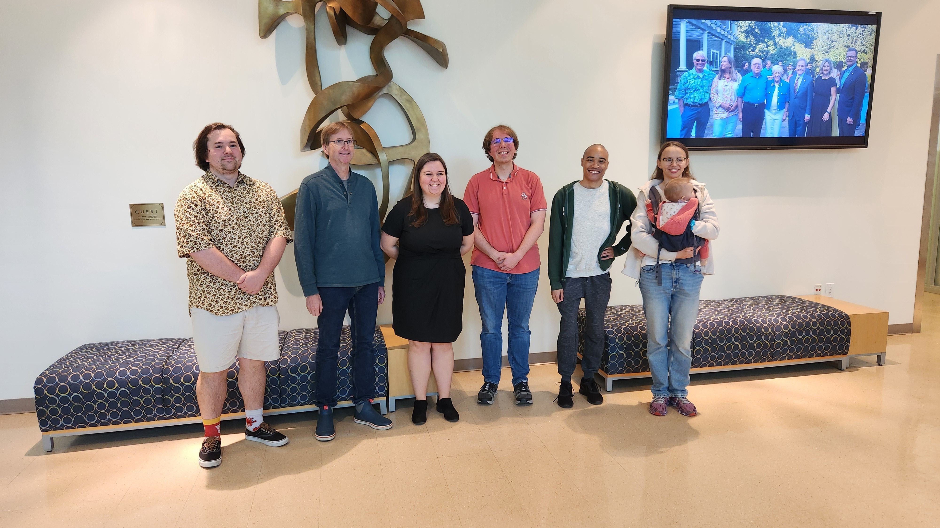


Acknowledgments
Simmerling Lab – Stony Brook University
Dr. Carlos Simmerling
Juan Alcantara
Zach Alseika
Dr. Lauren Raguette
Dr. Dasha Stephanko
Dr. Lucy Fallon
Dr. Yuzhang Wang
NIH
I’d like to thank the NIH for funding
via grant NIH GM107104.
Notes:
Change picture

Slide 11
How to best generate multiple ensembles under different conditions?
CLN_025
Alanine-12
HP24
Honda, S.; Akiba, T.; Kato, Y.; Sawada, Y.; Sekijima, M.; Ishimura, M.; Ooishi, A.; Watanabe, H.; Odahara, T.; Harata, K. 2008 J. Am. Chem. Soc. 130, 15327-15331.
Hocking, H.; Häse, F.; Madl, T.; Zacharias, M.; Rief, M.; Žoldák, G. 2015 Biophysical journal 108, 678-686
Notes:
Change this slide – more general

Slide 12
Structures generated with H1
Always accept exchange w/reservoir
Happens separately from exchanges between replicas
$$∆ =−\frac{1}{K_{b}T}∗[\left(E_{H2S1} −E_{H1S1}\right)−\left(E_{H1S2} −E_{H2S2}\right)]$$
Notes:
Change H1 and H2 on slide to H2 and H3 and then progress the slide by describing the reservoir and its generation constraints and then move to how it interacts with the other H’s
Then describe the technical constraints: Why does the reservoir have to exchange w/H1, etc.

Slide 13
H1 (Reservoir)
H2
H3
We use random pairing between replicas so each other H can attempt exchanges with our reservoir H
H1 (Reservoir)
$$∆ =−\frac{1}{K_{b}T}∗[\left(E_{H2S1} −E_{H1S1}\right)−\left(E_{H1S2} −E_{H2S2}\right)]$$
Notes:
Change H1 and H2 on slide to H2 and H3 and then progress the slide by describing the reservoir and its generation constraints and then move to how it interacts with the other H’s
Then describe the technical constraints: Why does the reservoir have to exchange w/H1, etc.

Slide 14
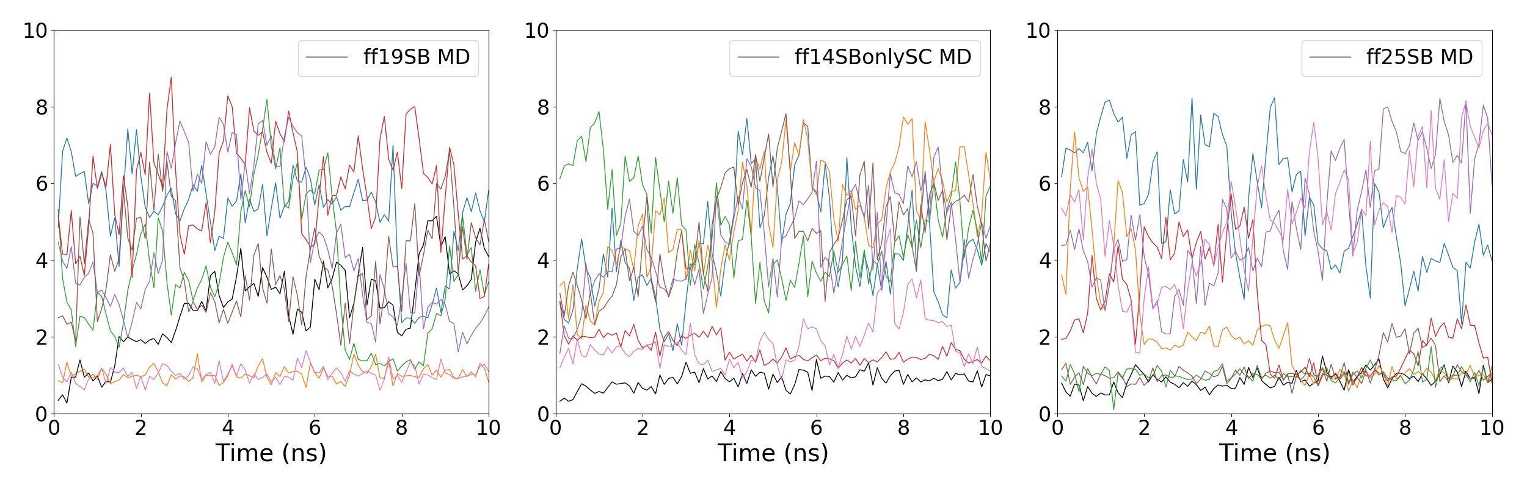
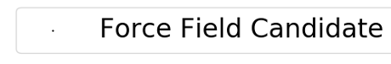
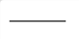
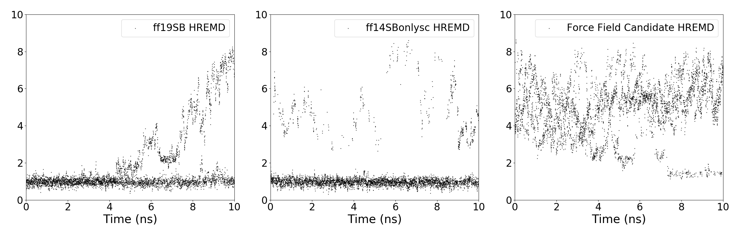
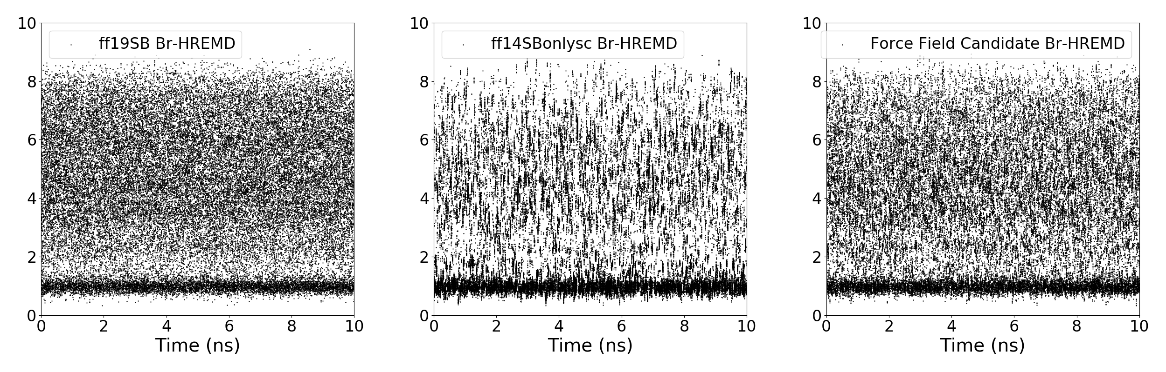
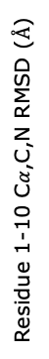
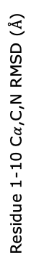
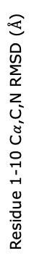
Residue 1-10 C$α$,C,N RMSD ($Å$)
Backbone RMSD vs time for
MD, HREMD, Br-HREMD
Residue 1-10 C$α$,C,N RMSD ($Å$)
Residue 1-10 C$α$,C,N RMSD ($Å$)

Slide 15
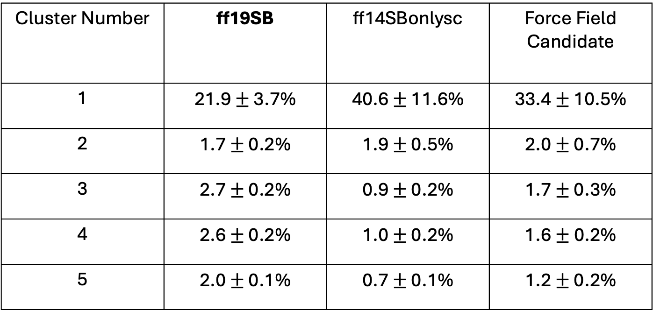
Cluster populations from clustering of all CLN025 MD trajectories
Cluster Number | ff19SB | ff14SBonlysc | Force Field Candidate
1 | 21.9 $±$ 3.7% | 40.6 $±$ 11.6% | 33.4 $±$ 10.5%
2 | 1.7 $±$ 0.2% | 1.9 $±$ 0.5% | 2.0 $±$ 0.7%
3 | 2.7 $±$ 0.2% | 0.9 $±$ 0.2% | 1.7 $±$ 0.3%
4 | 2.6 $±$ 0.2% | 1.0 $±$ 0.2% | 1.6$±$ 0.2%
5 | 2.0 $±$ 0.1% | 0.7 $±$ 0.1% | 1.2 $±$ 0.2%

Slide 16
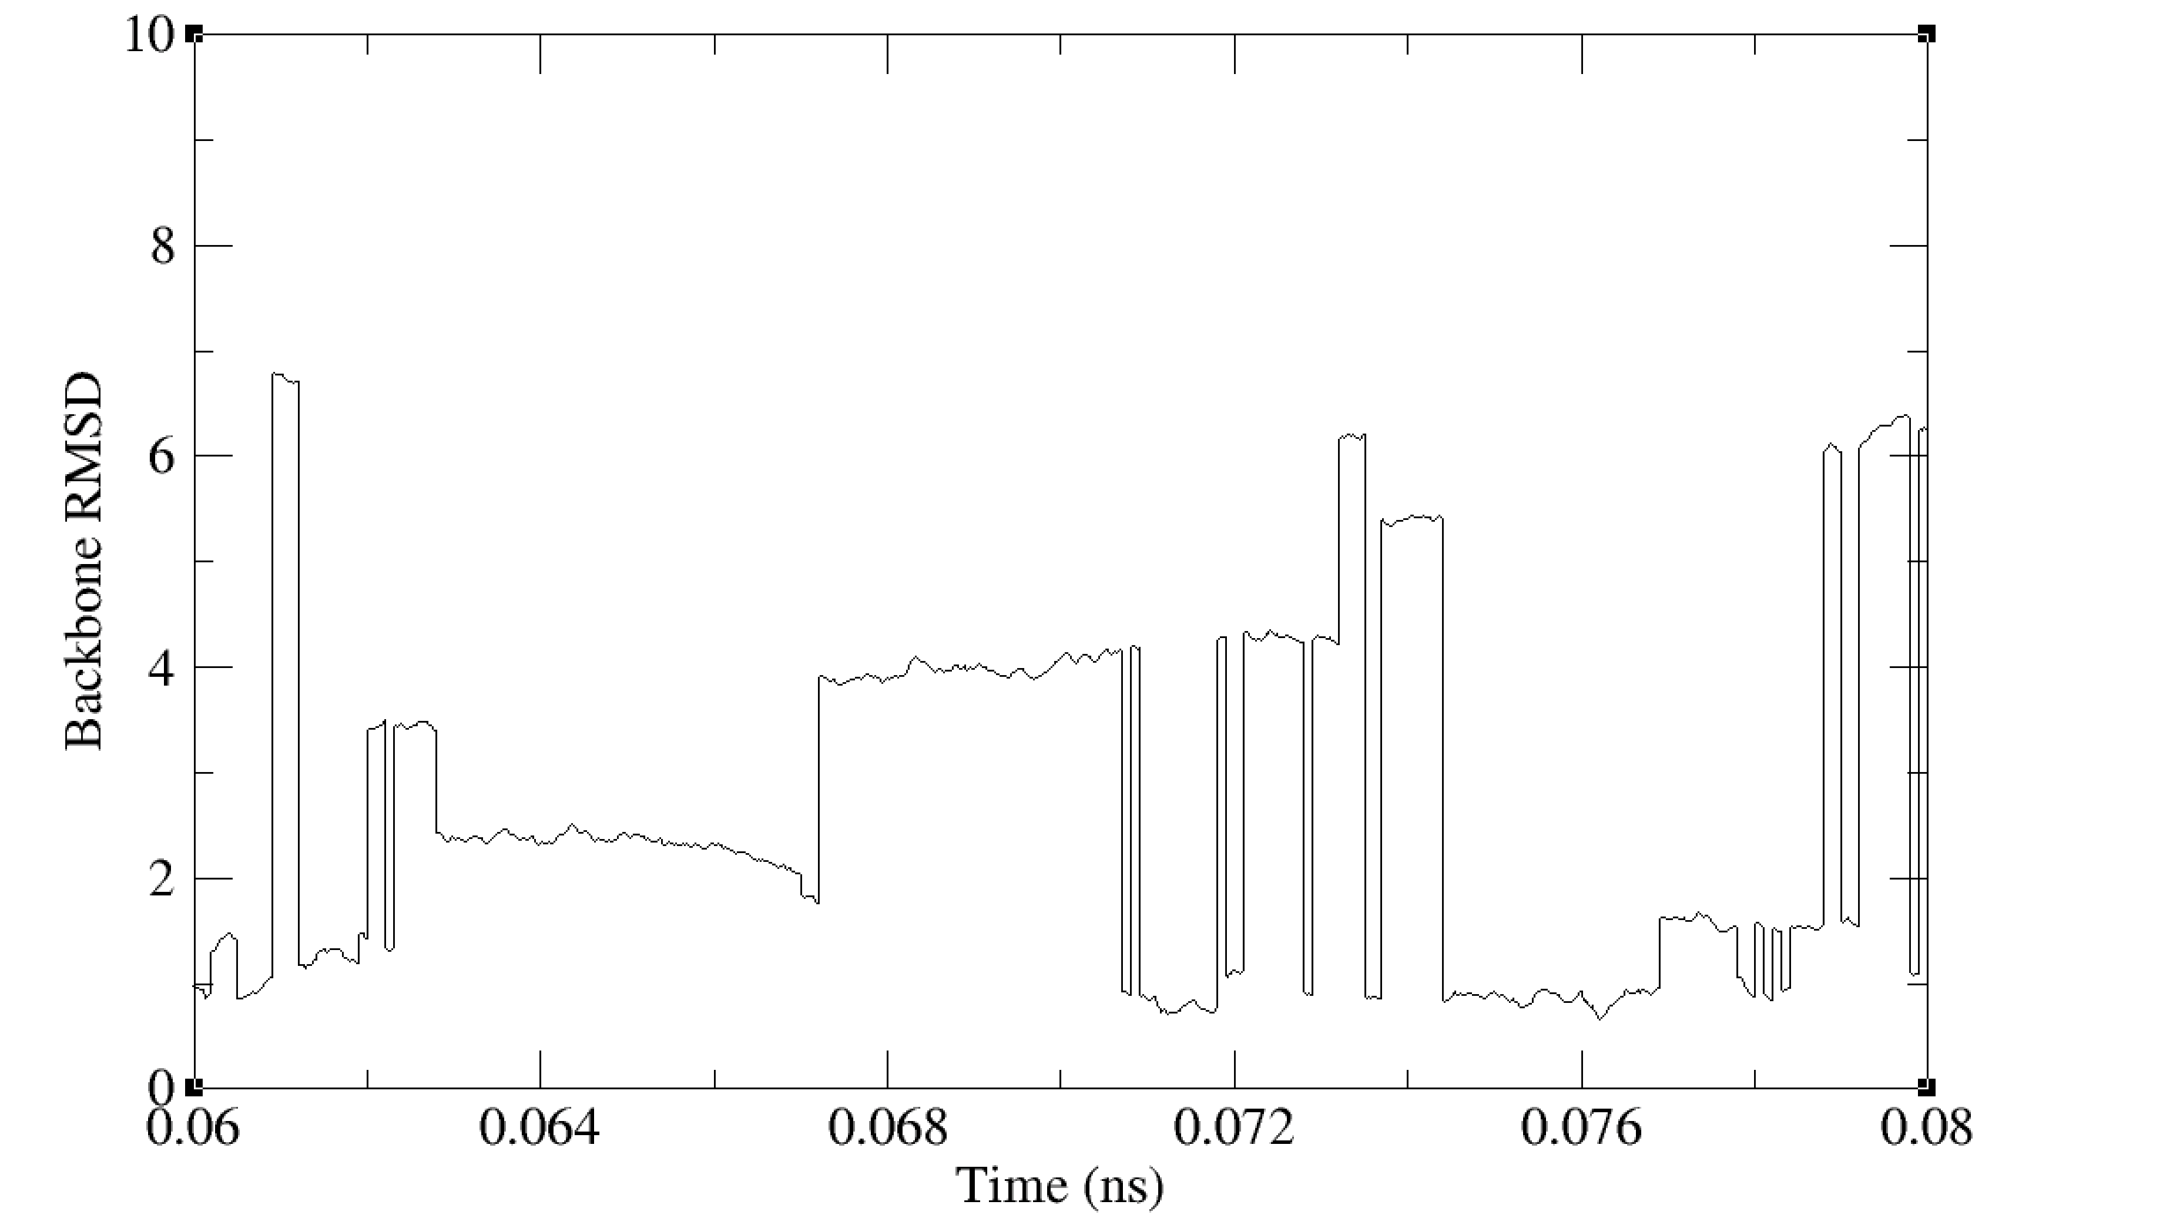
Backbone RMSD vs time for
Br-HREMD, 20 ps timescale

Slide 17
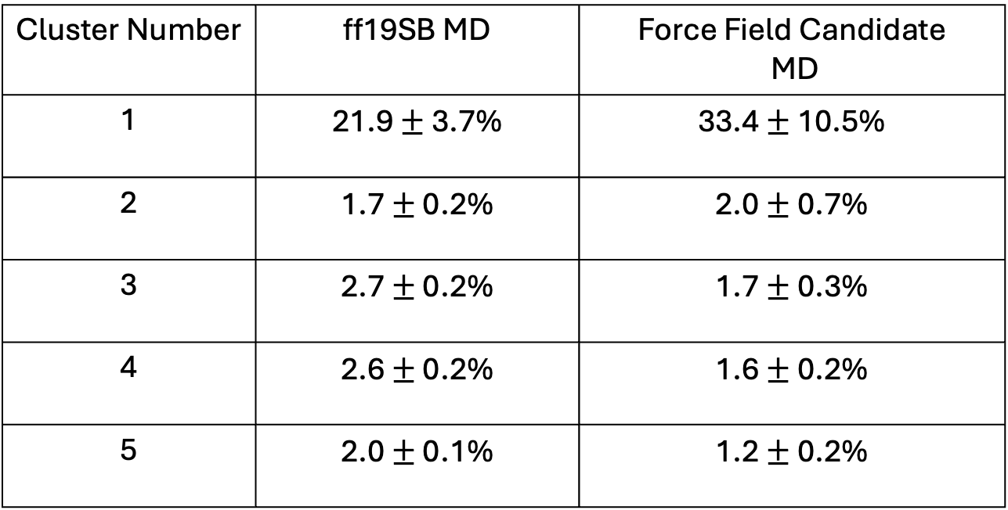
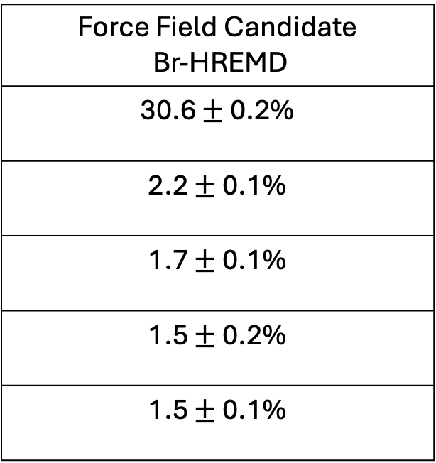
~3 months GPU time!
~3 months GPU time!
~2 hours GPU time!
Cluster Number | ff19SB MD | Force Field Candidate MD
1 | 21.9 $±$ 3.7% | 33.4 $±$ 10.5%
2 | 1.7 $±$ 0.2% | 2.0 $±$ 0.7%
3 | 2.7 $±$ 0.2% | 1.7 $±$ 0.3%
4 | 2.6 $±$ 0.2% | 1.6$±$ 0.2%
5 | 2.0 $±$ 0.1% | 1.2 $±$ 0.2%
Force Field Candidate Br-HREMD
30.6 $±$ 0.2%
2.2 $±$ 0.1%
1.7 $±$ 0.1%
1.5 $±$ 0.2%
1.5 $±$ 0.1%

Slide 18
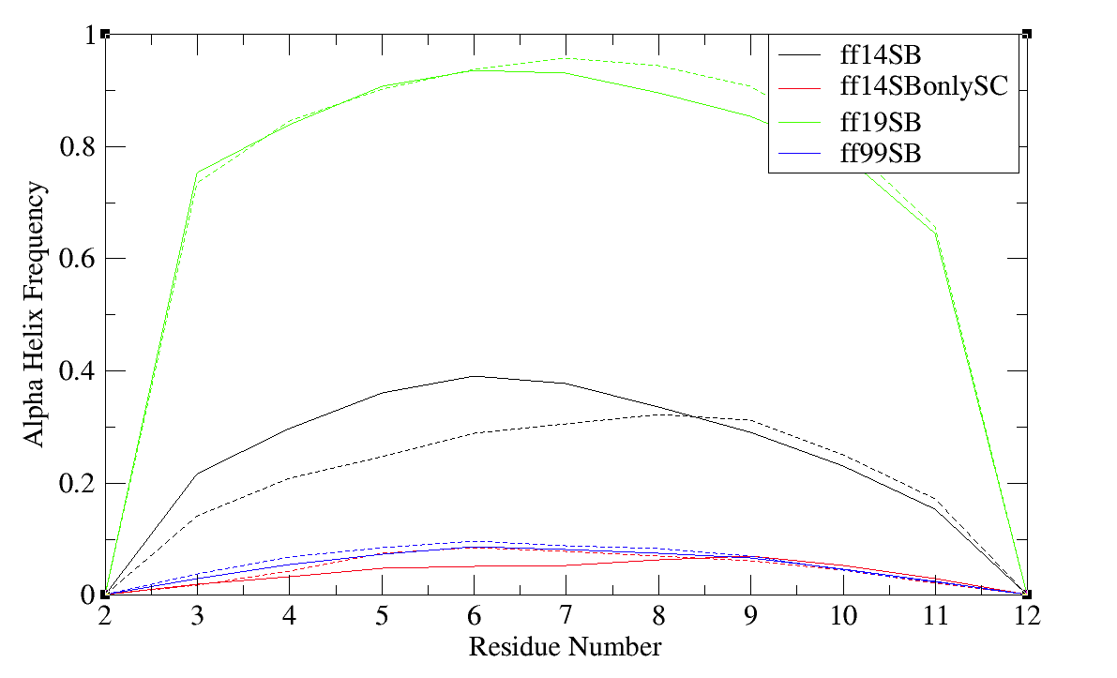
Comparing helical content from MD simulations
of Ala-12 with different force fields
Solid and dashed lines here are two independent runs. All sims run with TIP3P at 300K
Notes:
Remake with same Y-label as slides 19-21

Slide 19
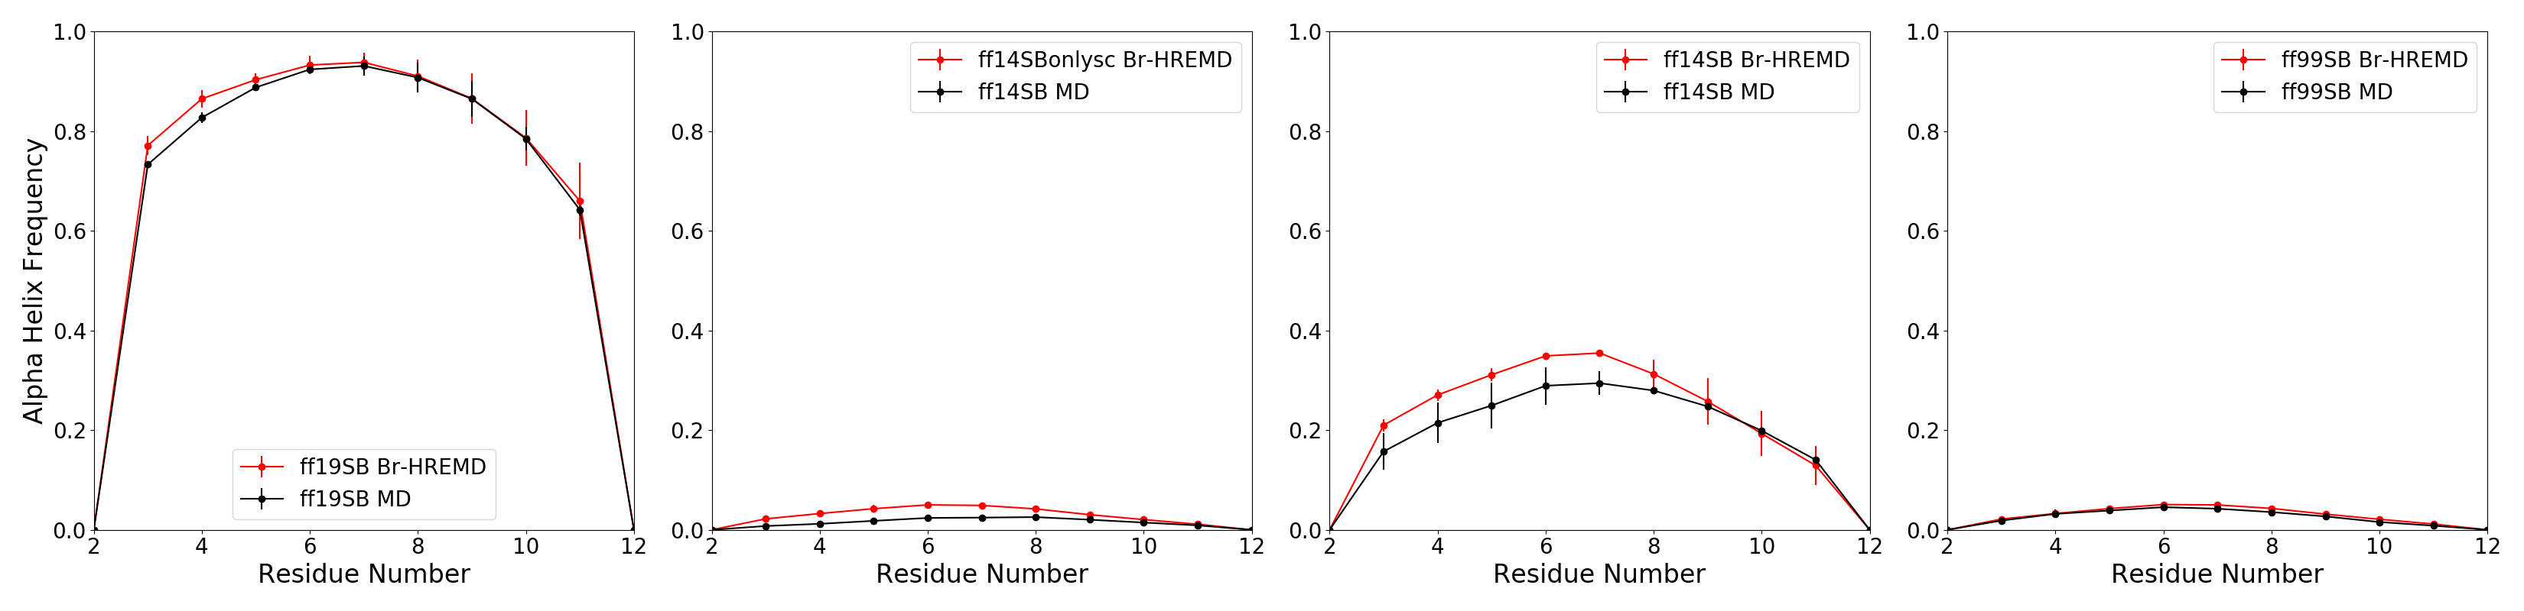
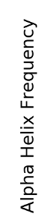

Slide 20
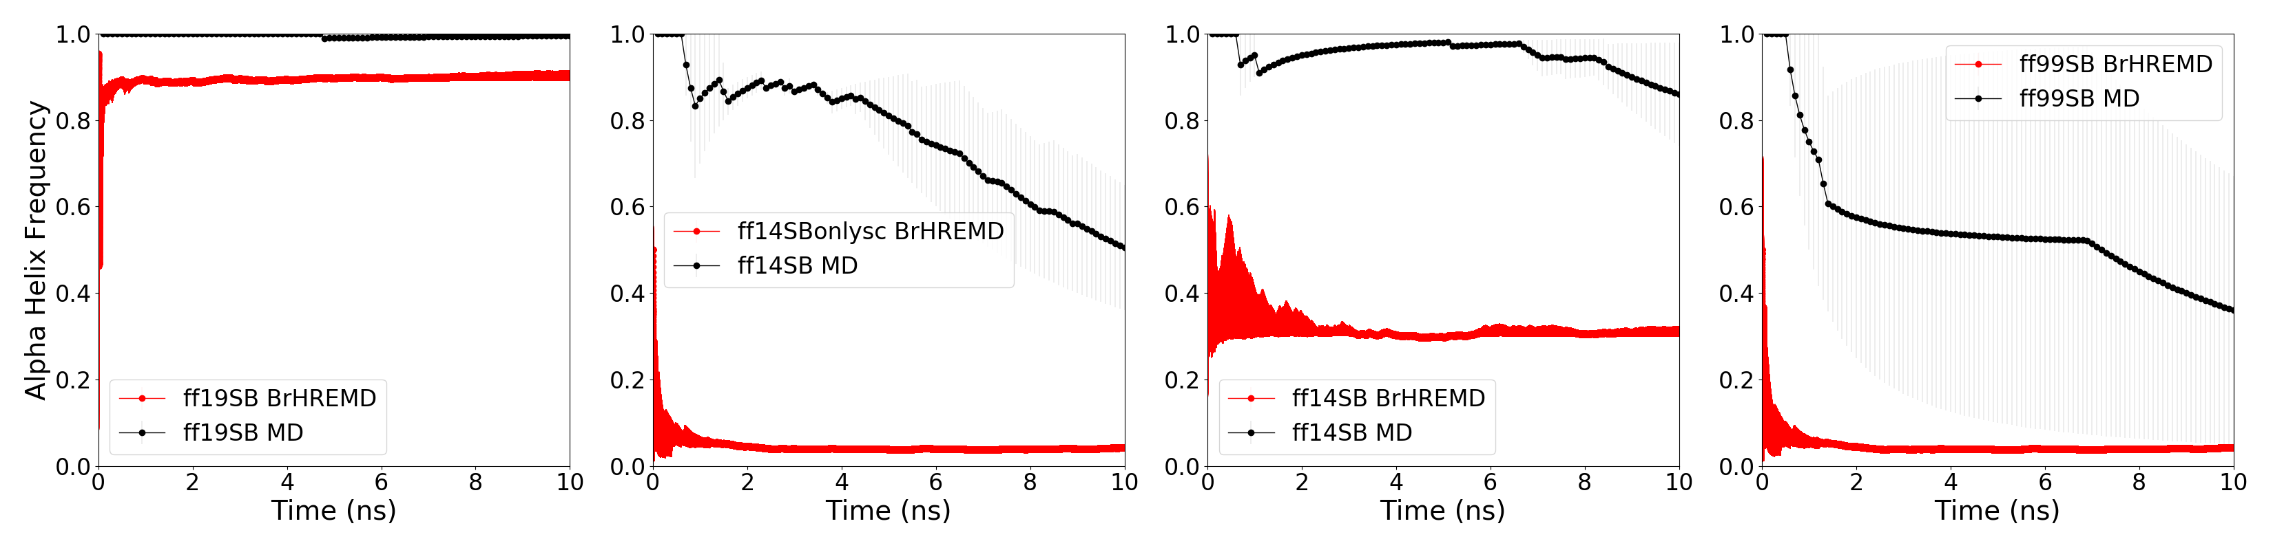
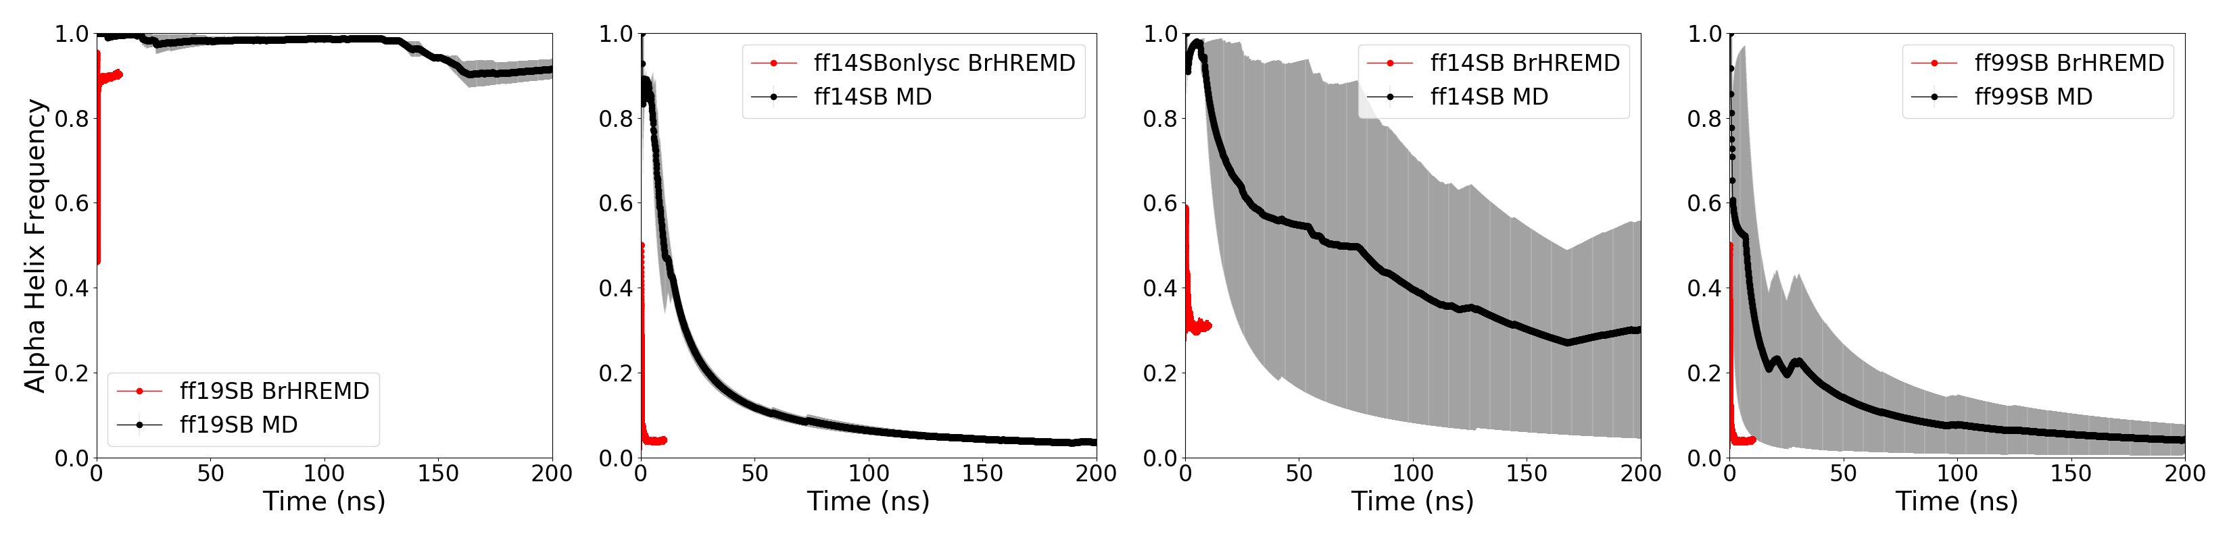
Notes:
Add slide after this which compares to std hREMD
Up font size in figuresl

Slide 21
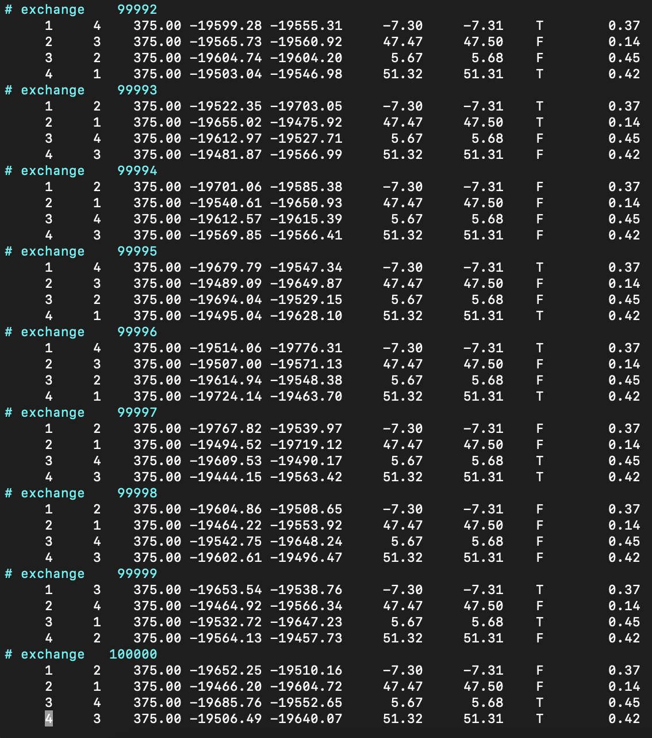
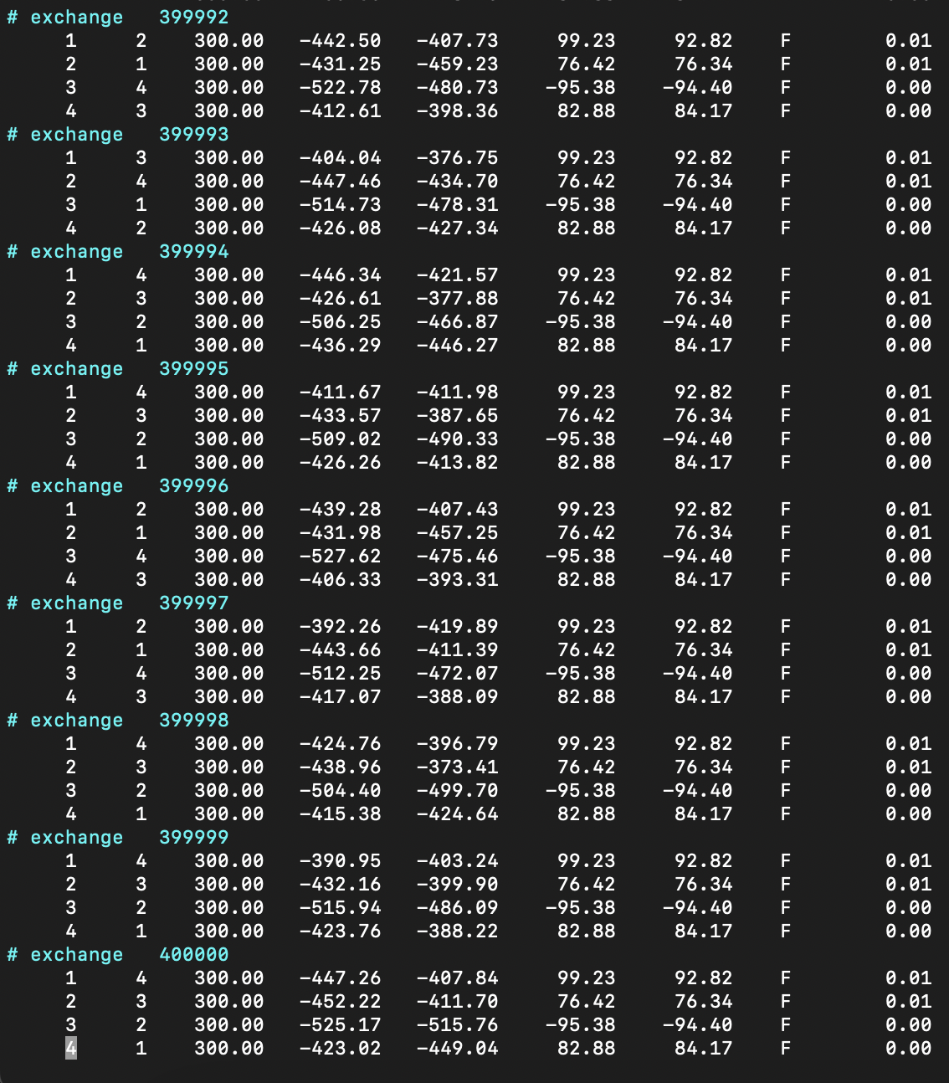
When in doubt, check the (rem) logs.

Slide 22
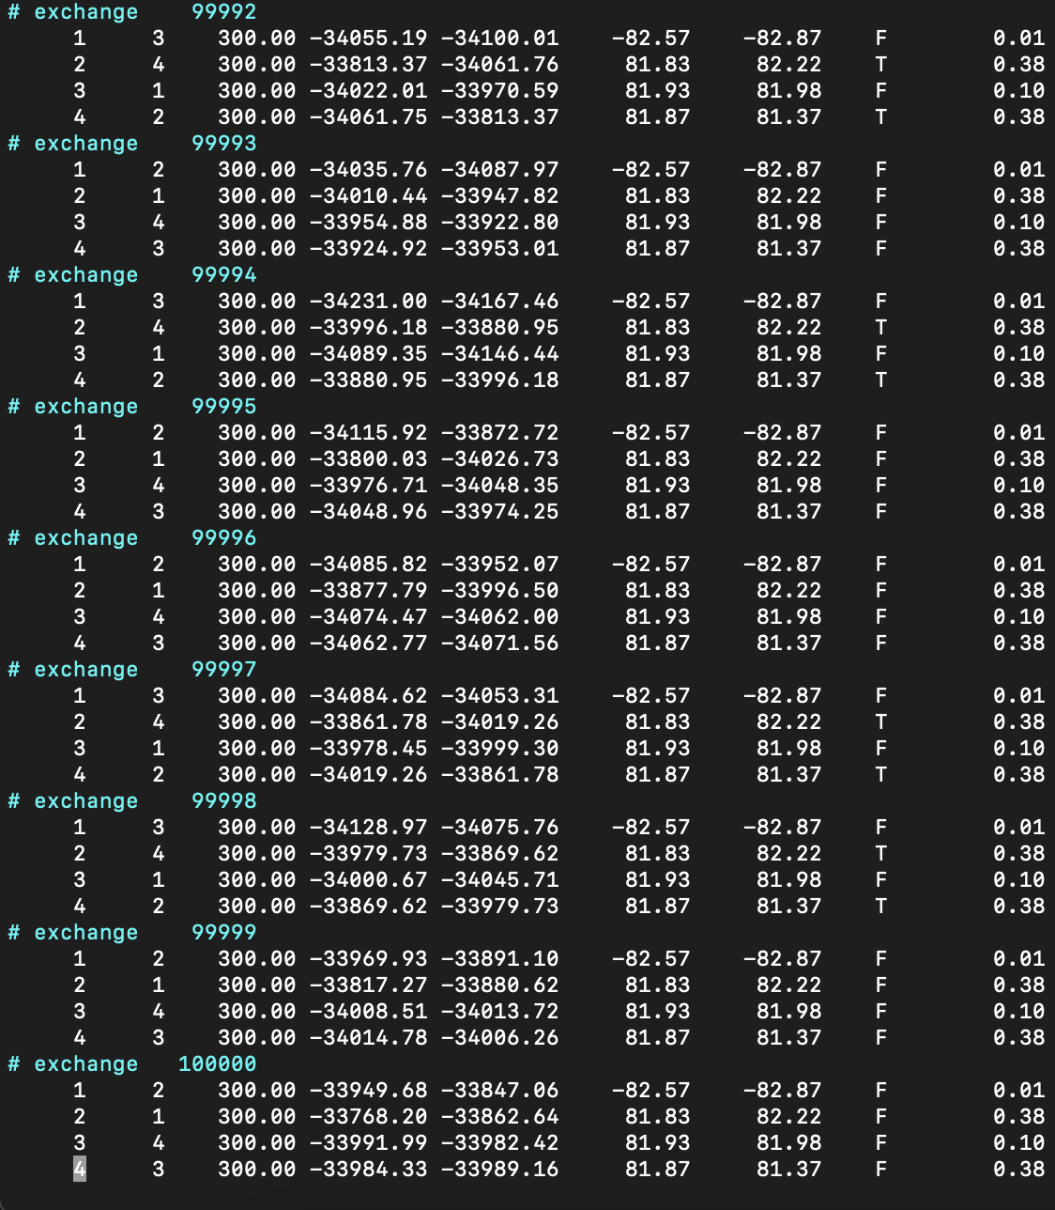

Slide 23
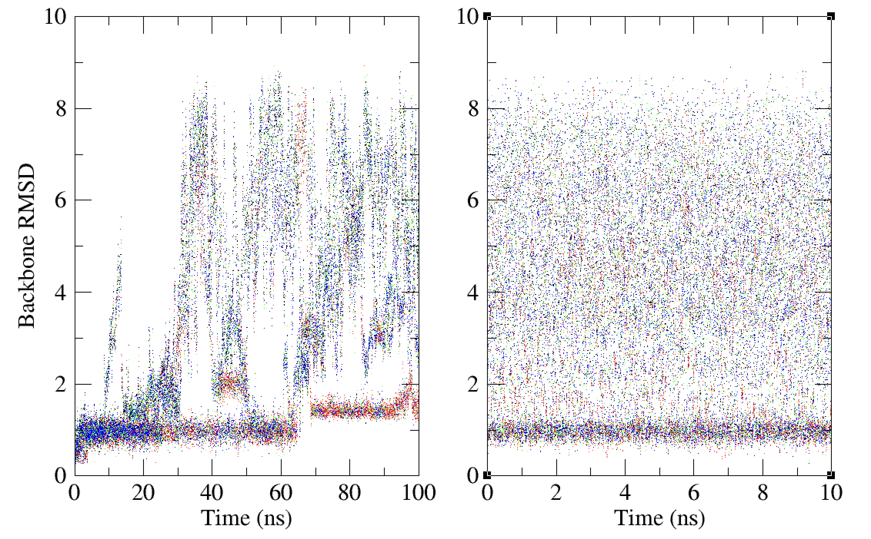
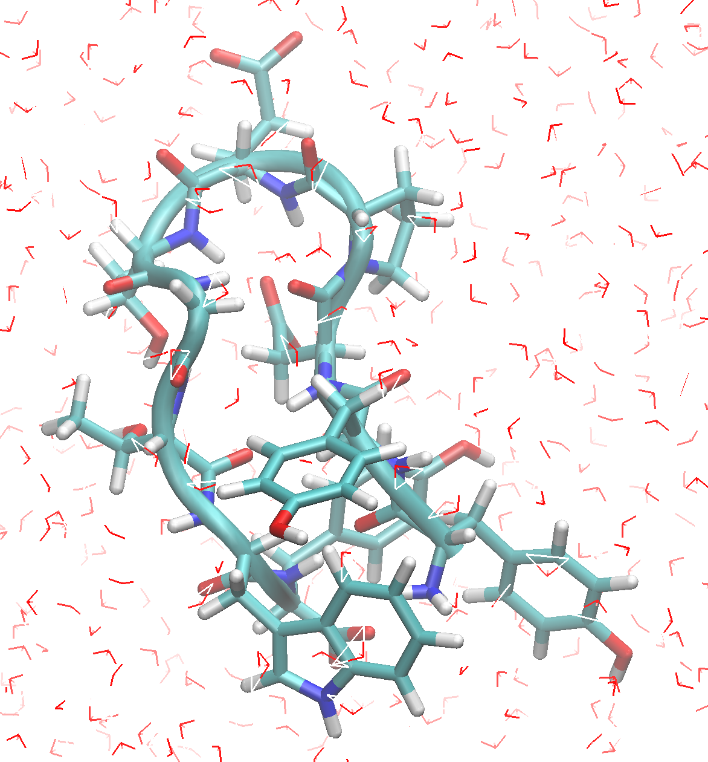
CLN025 with ff14SBonlySC/OPC, comparing HREMD and Br-HREMD, 375K
HREMD, H-data
Br-HREMD, H-Data
ff19SB
ff14SBonlysc
ff19SBnoPRO
ff24SBv3b

Slide 24
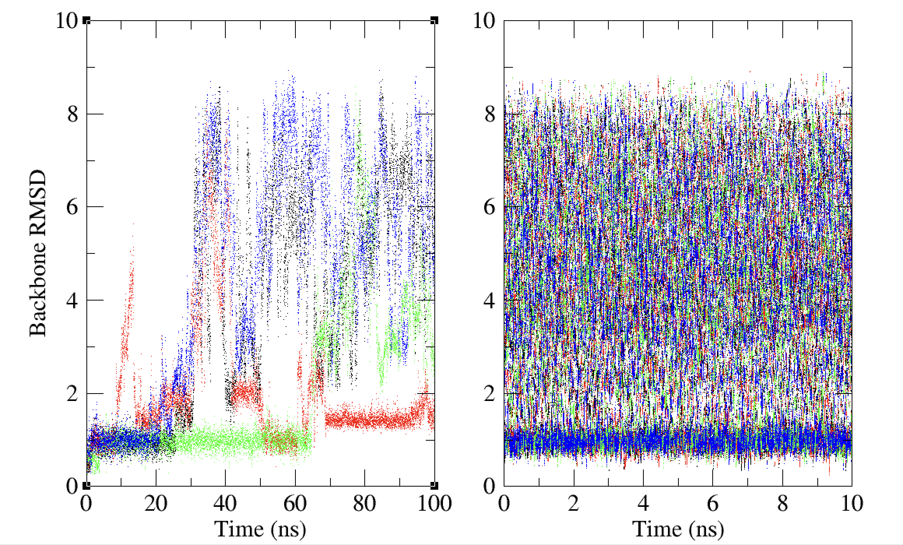
CLN025 with ff14SBonlySC/OPC, comparing HREMD and Br-HREMD, 375K
HREMD, rep-data
Br-HREMD, rep-Data
Rep1
Rep2
Rep3
Rep4

